Slide 1
SPECIAL ROLL
CHATHAM ROLL ..................................
Spicy crunchy tuna & mango inside, shrimp on top w. spicy sauce.
UNDER CONTROL ................................
Tempura shrimp & spicy crunchy tuna inside, caviar outside.
VOLCANO .........................................
Spicy crunchy tuna, salmon, yellowtail inside, caviar outside,
Chili sauce on top.
CRAZY EEL ........................................
Spicy crunchy tuna & avocado inside, eel on top w. eel sauce.
DYNAMITE .......................................
Spicy crunchy salmon inside & tuna on top.
SPIDER ROLL .....................................
Fried jumbo soft shell crab & cucumber inside,
Caviar outside with eel sauce.
CRAZY SALMON ..................................
Spicy crunchy salmon & avocado inside ,salmon, scallion on top
CRAZY TUNA .....................................
Pepper tuna & avocado inside, spicy crunchy tuna on top.
CROUCHING TIGER ..............................
Tempura shrimp inside, spicy crab meat on top w. miso eel sauce.
SUNSET BOULEVARD ............................
Spicy crunchy white tuna, mango & avocado inside, shrimp,
Crabmeat & avocado outside w. chef’s special sauce on the side.
MITSUBA ROLL ..................................
Pepper tuna & cucumber inside, salmon, eel , avocado outside ,
Spicy Wasabi eel sauce and caviar, scallion on top.
PINK LADY ........................................
Salmon ,shrimp, plantain, avocado, tempura flake & wasabi
Caviar wrapped In soybean paper with spicy sauce on side.
WONDERFUL ROLL ...............................
Tuna , salmon, yellowtail inside, various colors of
Caviar on the top.
LOBSTER ROLL ...................................
Lobster & avocado wrapped in soybean paper with spicy
Sauce on the side.
NEW CENTURY ...................................
Spicy crunchy tuna, avocado & cucumber inside, pepper tuna
Outside w. wasabi spicy sauce, tempura flake on the bottom.
SPICY CRUNCH LOBSTER .......................
Lobster avocado roll with salad, caviar and tempura flake
On top, miso & spicy sauce.
RED DRAGON .....................................
Fried jumbo soft shell crab, cucumber inside and eel, caviar
Outside with eel sauce on the top.
AMAZING .........................................
Fried jumbo soft shell crab, cucumber inside and tuna, eel,
Avocado outside with eel sauce on the top.
AUTUMN OF NEW JERSEY .....................
Spicy lobster & king crab, avocado, mango wrapped in
Tuna without rice. chef’s special sauce on the side.
TROPICAL ROLL ..................................
Shrimp, eel, crabmeat, avocado inside, tempura white fish outside ,
caviar, scallion & spicy , eel, mango sauce on top.
12
14.5
12.5
13.5
16.5
16.5
14.5
16.5
16.5
16
16.5
16.5
16.5
16.5
17.5
16.5
16.5
.
16.5
16.5
16.5
16.5
16.5
16.5
16.5
16.5
16.5
16.5
16.5
17.5
17.5
18
17.5
18
17.5
17.5
18
17.5
EASY ROLL ................................
Spicy crunchy tuna & avocado inside, caviar
Outside.
KANI NARUTO….........................
Crabmeat & avocado wrapped in thinly cucumber
Without rice. Spicy sauce on side.
ROCK & ROLL ..................... ........
Crunchy white fish, shrimp & crabmeat inside w.
Eel sauce. 5pcs, jumbo roll.
VEGETABLE DRAGON .....................
Cucumber, avocado, asparagus & Japanese pickle
Inside, sliced avocado on the top.
TUNA OR SALMON NARUTO ....... 16.5
Salmon or tuna &avocado wrapped in thinly
Cucumber without rice . Spicy sauce on side.
NARUTO .................................
Tuna ,salmon ,white fish, crab meat & avocado
Wrapped in thinly cucumber without rice.
MONTAUK ................................
Avocado inside and tuna outside, scallion
And spicy sauce on top.
FANCY ROLL ..........................
Spicy crunchy tuna, spicy white tuna, mango&
Avocado wrapped in soybean paper w. spicy sauce.
MAGIC .................................
Crunchy tuna avocado roll ,spicy miso & eel sauce,
Caviar, scallion on top. 5pcs, jumbo roll.
CRAZY SALMON ......................
Spicy crunchy salmon, avocado inside, salmon &
Scallion on top.
DRAGON ROLL ...........................
Eel & cucumber inside, sliced avocado outside
Tempura flake & eel sauce on top.
HIDDEN DRAGON ....................
Eel ,avocado & asparagus inside, spicy crunchy
Crab meat on top with spicy eel sauce.
PHOENIX .............................
Spicy crunchy white tuna & avocado inside,
Salmon outside.
POP UP ....................................
Shrimp, crab meat, spicy salmon, cucumber, avocado
Inside with tempura flake, caviar on top.
AMERICAN ............ ...............
Tuna ,salmon, yellowtail, shrimp, crab meat, cucumber,
Avocado inside, caviar outside. Jumbo roll , 5pcs.
LOVER ROLL ..........................
Spicy crunchy lobster & crab meat, mango, avocado
Wrapped in soybean paper with spicy sauce.
RAINBOW .............................
California Roll with tuna, salmon, shrimp,
White fish & avocado on top.
DINOSAUR ...............................
Tempura Shrimp & cucumber inside,
Eel & avocado on top w. eel sauce.
*
13

Slide 2
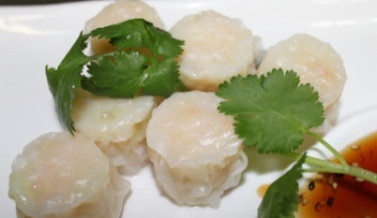
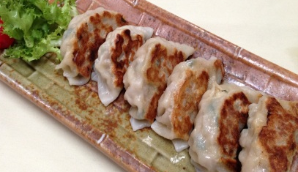
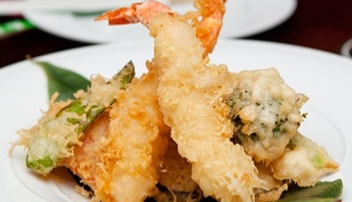
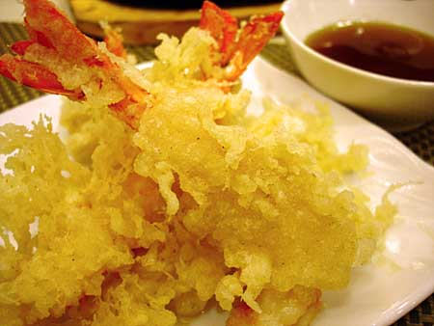
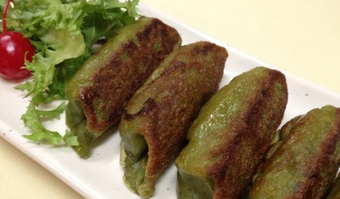
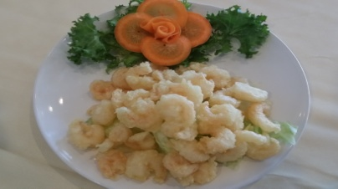
SOUP
BEVERAGES
Miso Soup
Clear Soup
Hamaguri Soup
Clam Soup
Seafood Soup
2.5
4
3.5
2.5
3.5
3.5
2
0.5
3.5
3
2.5
7
11
Soda
Japanese Soda
Juice
Ice Tea
Ice Green Tea
Sparkling Water
Bottle Water
Hot Green Tea
Shirley Temple
BEEF NEGIMAKI
SALAD
5
7
7
11
15
Green Salad
Seaweed Salad
Avocado Salad
Spicy Kani Salad
Crabmeat, cucumber,
caviar, tempura flake
mixed w. spicy sauce.
Red Snapper
Tempura Salad
SHRIMP SHUMAI
B.B.Q 2 skewers
Chicken
Beef
Shrimp
Vegetable
10
11
11
6
GYOZA
2 Skewers per Order
6
7
8
4
STARTER FROM KITCHEN
Gyoza
Pan fried pork dumpling, 6pcs.
Vegetable Gyoza
Pan fried veg. dumpling
Shrimp Shumai
Steamed shrimp dumpling
Wasabi Shumai
Pork dumpling w.
wasabi flavor. (steamed )
Spring Roll
Shrimp or vegetable
Chicken & Vegetable
Tempura APP
Shrimp & Vegetable
Tempura APP
Vegetable Tempura APP
Tempura Soft Shell Crab
& vegetable
Edamame
Steamed soybean
Beef Negimaki
Beef scallion roll, 6 pcs.
Eggplant Miso
Broiled eggplant marinated
with miso sauce
Calamari Ring Fried
Ika Shogayaki
Grill squid w.
ginger sauce
Kaki Fried
Deep fried oyster
Age Tofu
Fried bean curd
8.5
7
7
7
6.5
11
12
9
12
6.5
12
11
16
17
9
6.5
IKA SHOGAYAKI
SHRIMP TEMPURA
VEGETABLE GYOZA
Rock Shrimp
With Honey Wasabi Sauce
16
ROCK SHRIMP

Slide 3
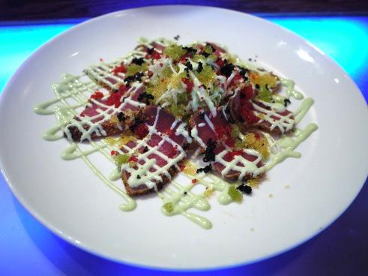
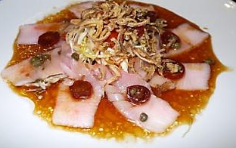
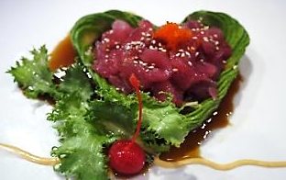
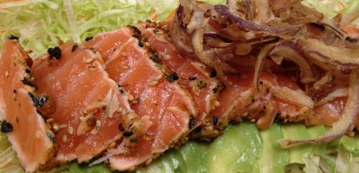
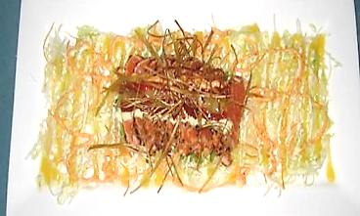
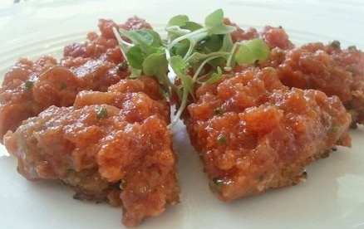
STARTER FROM SUSHI BAR
Pepper Tuna w. Creamy
Wasabi Sauce ......17
Pepper tuna salad w. wasabi
Sauce & various colors caviar.
Japanese Pizza.....18
Crispy pancake w. spicy seaweed
Salad. Sliced salmon, caviar
And green scallion on top.
Yellowtail carpaccio...18
Grape tomato, caper, olive
Oil & soy sauce.
Pepper Tuna w. Creamy Wasabi Sauce ....
Pepper tuna salad w. cream wasabi sauce &
5 various colors of caviar on top.
Spicy Tuna Tartar (With miso & mango sauce) ....
Tuna Avocado Yuzu (Citrus Juice) Sauce ......
Yellowtail Carpaccio .........................
Sliced yellowtail w. carpaccio sauce
(caper, grape tomato, olive oil & soy sauce.)
Japanese pizza ..............................
Crispy panacke with seaweek salad, sliced salmon, caviar &
Green scallion on top.
Salmon Tataki ...............................
Lightly seared salmon w. salad .
Spicy mango $ wasabi sauce on top.
Usuzukuri (Thin sliced fluke w. ponzu sauce) ........
Red Snapper with Yuzu Sauce ( Citrus Juice ) .
Treasure Island .............................
Assorted fish on avocado boat w. spicy & yuzu sauce
Tako Su ( Otopus, cucumber, in vinegar sauce ) ......
Spicy Tuna w. Crispy Rice Cake ...........
Sushi APP ( 4 pcs. ) ........................
Sashimi APP ( 7 pcs. ) .....................
Sunomono ( Marinated seafood in vinegar sauce ) ....
13
12
13
15
14
13
12
12
11
9
10
9
11
9
Salmon Tataki........18
Lightly seared salmon w. salad
And avocado. Spicy mango&
Wasabi sauce on top
Tuna Avocado Yuzu...18
Citrus Juice sauce.
Spicy Tuna Tartar...17
Avocado & miso mango sauce.
Treasure Island.......17
assorted fish on avocado boat w.
Spicy yuzu sauce.
Usuzukuri..............18
Sliced thinly fluke w. ponzu sauce.
Sushi App (4 pcs.)....12
Sashimi App (7 pcs.)..16
Red Snapper w. Yuzu
Sauce.( Citrus Juice)....17
Tako Su...............17
Otcopus, cucumber in sweet
Vinegar sauce.
Sunomono.............15
Smoke salmon, shrimp, kani &
White fish in vinegar sauce.
Spicy Tuna w. Crispy
Rice cake.............16
A LA CARTE
SUSHI OR SASHIMI ( 2 PCS. PER ORDER )
Shrimp ( Ebi ).......................
Sweet shrimp ( Amaebi )............
Surf Clam ( Hokkigai ).............
Flying Fish Roe ( Tobiko ).........
Squid ( Ika ).........................
Octopus ( Tako )....................
White Tuna........................
Bean Curd ( Inari )...................
Crab Stick ( Kani )..................
Egg ( Tamago ).......................
Salmon Roe ( Ikura ).................
7.5
7.5
7.5
M/P
7.5
7
7
7
6.5
7.5
8.5
M/P
6.5
9
6
7
6
7
7
5
6
5
10
Tuna ( Maguro )......................
Salmon ( Sake ).....................
Yellowtail ( Hamachi )................
Sea Urchin ( Uni )...................
Fluke ( Hirame )......................
Mackerel ( Saba )....................
Spanish Mackerel ( Sawara}.........
Eel ( Unagi ).........................
Red Snapper ( Tai )..................
Smoke Salmon......................
Scallop ( Hotategai )...................
Fatty Tuna (Toro) ................

Slide 4
ROLL OR HAND ROLL
Avocado
Cucumber
Crab Stick
California
Crabmeat, cucumber, avocado
Vegetable
Avocado, cucumber, kanpyo, oshinko, asparagus
Shitake ( mushroom )
Sweet Potato
Shrimp
Shrimp Tempura
Salmon
Smoke Salmon
Salmon Skin
Alaska
Salmon, avocado, cucumber.
5.5
5
5.5
7.5
6.5
5.5
6
7
8.5
7.5
8
7
8
Tuna
White Tuna
Pepper Tuna
Yellowtail w. Scallion
Spicy Tuna
Spicy Salmon
Spicy Yellowtail
Spicy Scallop
Eel Avocado/Cucumber
Boston
Shrimp, cucumber, lettuce & mayonnaise
Philadelphia
Smoke salmon, avocado, cream cheese.
Futo Maki
Egg, crabmeat, oshinko, cucumber, avocado.
7.5
7.5
7.5
7.5
8
8
8
9
8
7.5
8.5
8
SUSHI ENTREES
Served w. Soup & Salad
Sushi Deluxe ( 10 pcs. of assorted sushi & tuna roll ) ...............................
Sashimi Deluxe ( 18 pcs of sashimi ) ...........................................
Sushi& Sashimi Combo ( 10 pcs. of sashimi, 6 pcs. of sushi & tuna roll ) ................
All Tuna or Salmon Sushi Deluxe ( 12 pcs. sushi. ) ...........................
All Tuna or Salmon Sashimi ( 15 pcs. sashimi. ) ...............................
Tekka Don or Salmon Don ( Slice tuna or salmon over seasoned sushi rice. ) .........
S.T.Y Sushi Deluxe ( 5 pcs. each of tuna, salmon & 3 pcs. of yellowtail ) ..............
S.T.Y Sashimi Deluxe ( 5 pcs. each of tuna, salmon, yellowtail ) ...................
28
31
33
31
34
30
31
34
60
68
22
27
20
21
22
22
Sushi For Two ( 16 pcs. of sushi, spicy tuna roll, shrimp tempura roll, dragon roll ) ........
Love Boat For Two ( 10 pcs. of sushi,18 pcs. of sashimi, spider roll, rainbow roll ) .......
Tuna Lover ( Spicy tuna roll, tuna roll, 1 pc. each sushi of tuna, white tuna , pepper tuna ) ..
Chirashi ( Variety of raw fish & Japanese pickles with sushi rice. ) ......................
California Roll Dinner ( 3 California roll ) ......................................
Maki Combo ( Tuna roll, salmon roll, California roll ) ...............................
Spicy Maki Combo ( Spicy tuna roll, spicy salmon roll, spicy yellowtail roll ) ............
Vegetable Sushi Dinner ( 8 pcs.of veg. sushi & vegetable roll ) .....................

Slide 5
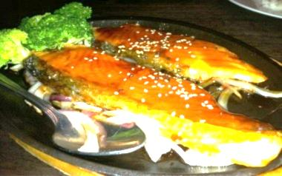
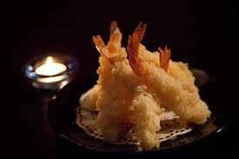
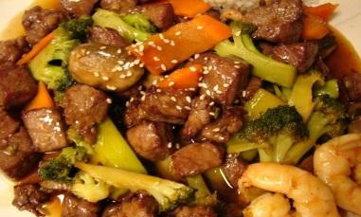
KITCHEN DINNER ENTREES
A. TERIYAKI
(Served w. Soup, Salad & Rice)
Teriyaki dishes served w.
Treiyaki sauce on a sizzling hot plate
17
16
23
24
25
26
25
26
Shrimp & Chicken ....
Steak & Chicken .......
Shrimp & Steak ......
Scallop ...................
Duck ....................
Seafood Kabob .........
3 skewered shrimp, salmon, scallop
And vegetable
Chilean Sea Bass .......
Seafood Combo ........
Lobster tail, shrimp, scallop & salmon
Mixed Vegetable .......
Tofu ....................
Chicken .................
Red Snapper ...........
Beef Negimaki..........
Beef scallion roll
Salmon ..................
Shrimp ..................
Beef Steak .............
28
29
29
30
29
30
38
35
B. HIBACHI
(Served w. Soup, Salad & Rice)
Hibachi dishes are cooked w.
special soy sauce
Salmon
Teriyaki
Vegetable ..............
Chicken .................
Beef Steak .............
Shrimp ..................
Scallop ..................
Shrimp & Chicken ......
Steak & Chicken .......
Shrimp & Steak ........
17
25
28
27
31
30
31
31
C. TEMPURA
(Served w. Soup, Salad & Rice)
Lightly battered & crispy deep fried,
Tempura sauce on the side
Mix Vegetable ..........
Chicken & Vegetable ...
Shrimp & Vegetable ....
18
22
24
Beef &
Shrimp
Hibachi
Shrimp
Tempura

Slide 6
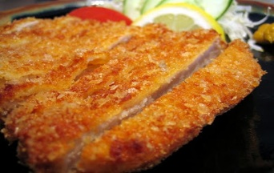
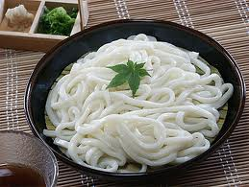
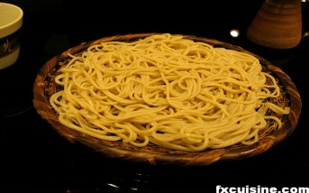
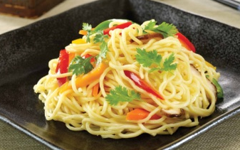
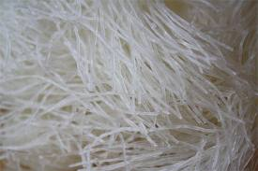
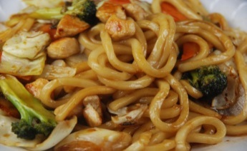
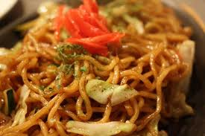
D. AGEMONO
(Served w. Soup, Salad & Rice)
Tonkatsu (pork) .................................
Toriatsu (chicken) ..............................
22
22
(Deep fried in Bread crumb)
E. NABE MONO
Tonkatsu
Served w. Salad & Rice
(Noodle Soup)
Ishikari Nabe ...................................
Salmon, bean curd, vegetable and yam noodle in miso soup.
Sukiyaki ..........................................
Sliced beef, tofu, yam noodle, vegetable in sweet sukiyaki
Soup.
Yose Nabe .......................................
Salmon, clam, scallop, shrimp, yam noodle and vegetable in
Clear soup.
Nabe Yaki Udon .................................
Shrimp tempura, clam, chicken, egg & vegetable in clear soup
27
28
30
22
Undon Noodle
Soba Noodle
F. UDON OR SOBA
(Served w. Salad)
(Stir-fried Noodle)
Udon (white ,thickest noodle made by wheat flour)
Soba(yellow, thin noodle made by wheat flour)
Chicken Yaki Udon or Soba ....................
Beef Yaki Udon or Soba ......................
Shrimp Yaki Udon or Soba .....................
Vegetable Yaki Udon or Soba .................
Yam Noodle
18
19
19
16
G. JAPANESE FRIED RICE
(Served w. Salad)
Stir-fried Udon
Chicken Fried Rice ..............................
Beef Fried Rice .................................
Shrimp Fried Rice ..............................
Vegetable Fried Rice ..........................
17
18
18
16
Stir-fried Soba

